Slide 1


Data Hikers
University of Washington
University of California - San Diego
University of Minnesota
Camila Valdebenito
Allston Fojas
Governess Simpson
MENTOR: Maury Turay
Notes:
NIC

Slide 2
BUSINESS LANDSCAPE
Hypothesis: Our business will be successful in Zip Codes where business longevity, population density and high median income are historically high.
Key Takeaways
What makes a business successful?
Business Longevity
High Population Density
High Median Income
Landscape
Business Type
Product

Slide 3
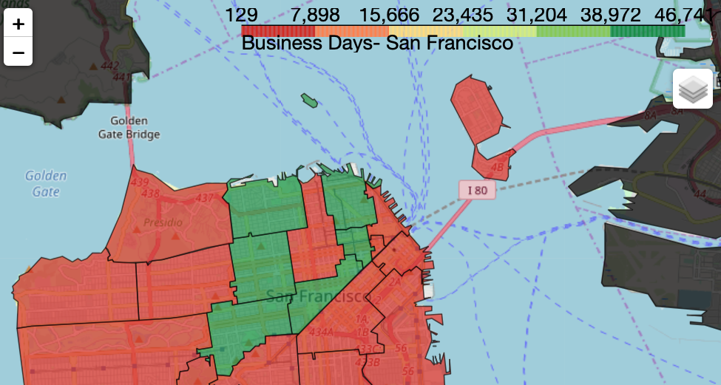
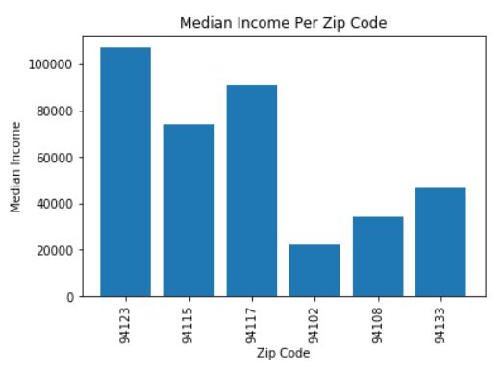
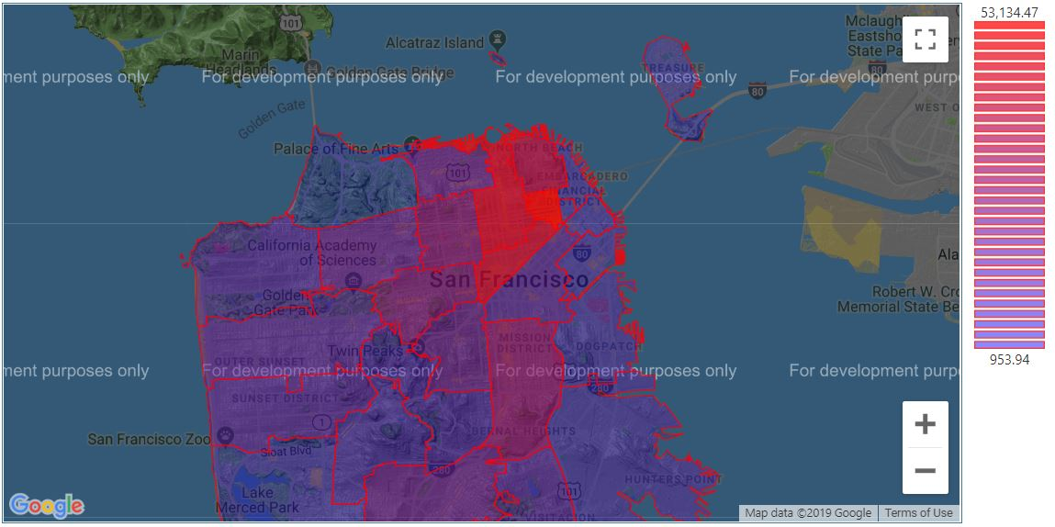
BUSINESS LANDSCAPE BY ZIP CODE
Business Longevity by Zip Code
Business Landscape Metrics:
Business Longevity
Population Density
Median Income
94123
94133
94108
94115
94102
94117
Population Density by Zip Code
94123
94133
94108
94115
94102
94117
Landscape
Business Type
Product

Slide 4
TYPE/LOCATION OF BUSINESS
We calculated the top 6 Zip Codes based on business longevity and determined their different business specializations.
To find business specializations, we found the most frequent industries per Zip Code.
Key Takeaway
Our recommendation: Zip Code 94117 (Hayes Valley and Haight-Ashbury) is best suited for a retail-based business.
Relative to adjacent neighborhood, retail-based businesses were underserved in this area.
Landscape
Business Type
Product

Slide 5
METHODOLOGY
We defined business longevity as the number of days that businesses in a Zip Code have been open.
Additionally, we cross-referenced business longevity from the SF business data set with population density and median income from census data.
Key Takeaways
We found the top 6 Zip Codes based on business longevity.
We integrated Census data with the SF Business Data Set.
Landscape
Business Type
Product

Slide 6







PRODUCT
Key Takeaway
Our recommendation: A Recommender-based widget within Messenger App to promote newly-opened, trending businesses to tourists in San Francisco
Landscape
Business Type
Product

Slide 7
WHO DOES IT APPEAL TO?
Gen-Z and Millennials
Instagram integration of trending/most popular businesses
Gen X and Older Generations
Customization and ability to alter recommendations that are not necessarily trending
Entrepreneurs and Business Owners
Perform research on most popular businesses and their location
Start/End Dates | Business Type/Industry | Neighborhood | Longitude/Latitude
Landscape
Business Type
Product

Slide 8
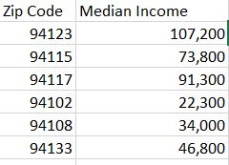
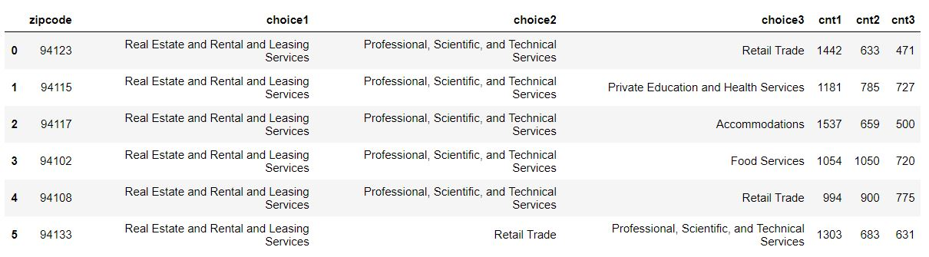
APPENDIX

